Slide 1

Master‘s Thesis Presentation
Richard Otto
Technical University of Munich
Department of Informatics
Chair of Robotics, Artificial Intelligence and Real-time Systems
Munich, 30. August 2019
Notes:
Hallo,
I'm Richard and I'll presenting you an Overview about my Master Thesis
with the Title.............

Slide 2
Autonomous Control for Wheel-less Snake Robot based on Neuromorphic Vision Sensor and Spiking Neural Network
Richard Otto
Supervisor: Prof. Dr.-Ing. habil. Alois Christian Knoll
Advisor: Zhuangyi Jiang
Munich, 30. August 2019

Slide 3
Content
Motivation
Problem description
Setup
Training
Testing
Conclusion
Notes:
The Content of my Talk subdivides in this Sections
...... so let's move on to the Motivaton

Slide 4
Motivation
Autonomous robots have huge utilities:
Search and Rescue
Exploration
Transportation
Key Ability: Real Time Navigation
Developments in Computer Science and Engineering make this goals reachable:
More computational power
New mathematical methods and models
Improvements in sensors and hardware
Notes:
special shapes, sizes help to performe better
and no humans are getting endangered
which is more and more reachable by developments....

Slide 5
Problem description
Goal: Target tracking
Platform/Setup:
Snake-like Robot
Dynamic Vision Sensor
Spiking Neural Network
Neurorobotic Platform
Technique:
R-STDP learning
Notes:
task I try to solve in the thesis is a Target Tracking Task

Slide 6
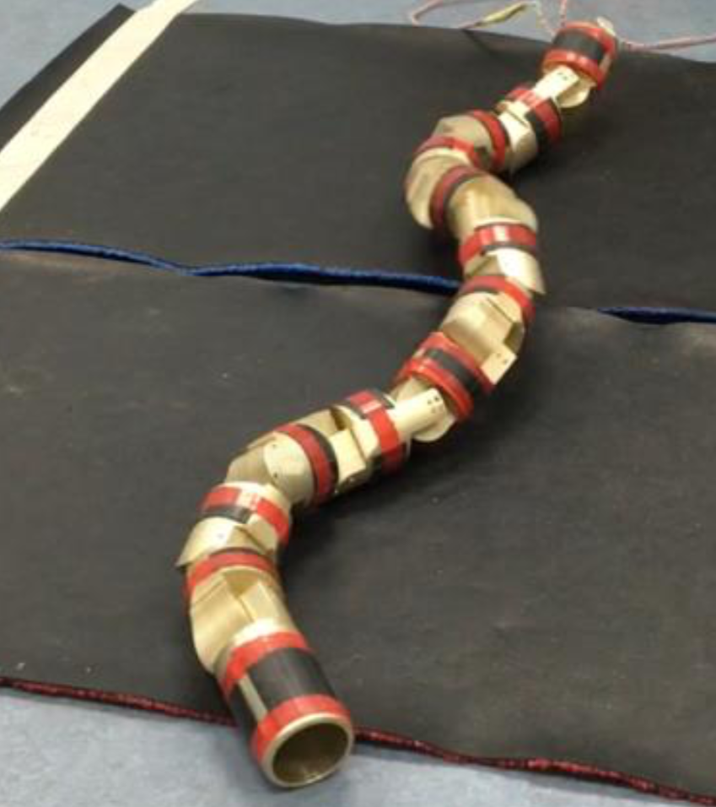
Robot
Snake-like Robot
Owned by Chair
Versatile Movement Options
Slithering Gait used
Mimics biological movement
Head faces in movement direction
but moves from left to right
Z. Jiang [Jia18]
Notes:
allowing vision by headmounted sensor

Slide 7
Dynamic Vision Sensor
Tracks Change of Pixel Readings
Sends Event if Change overcomes Threshold
Event: <pixel_ID,event_Time,polarity>
Eventstream is served via a Bus by the Sensor
Advantages over Cameras:
High temporal resolution
Less overhead by not using Frames
Resulting in less computational effort
Less energy consumption
Higher responsiveness
Notes:
event is tuple of ......
polarity: direction of change ( undercut / exceeded )
great deal for autonomous systems
…goes along with Less Energy Consumption….

Slide 8
Spiking Neural Network
Neurons:
Leaky Integrate and Fire
Model of biological Neuron
Fires if Activation Level reaches Threshold
Activation decays (Leak)
Synapses:
Reward modulated STDP-Learning
STDP-Learning used to update eligibility
Dopamine level corresponds to the Reward

Slide 9
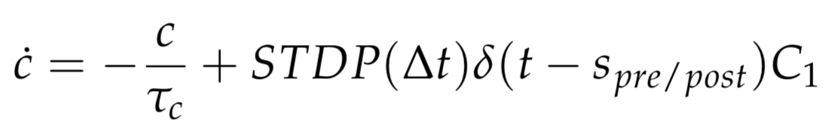
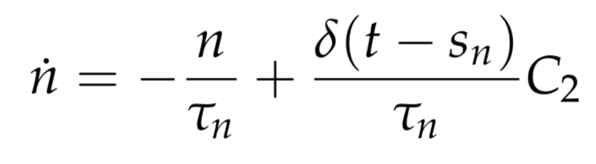
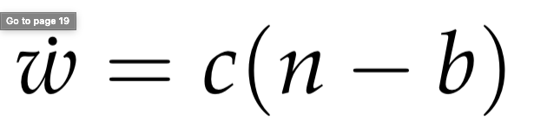
Spiking Neural Network – R-STDP
R-STDP Mechanism (R. Legenstein [L08])

Slide 10
Neurorobotics Platform
Used for simulating the Robot controlled by an SNN in a closed Loop
Controls SNN-Simulation and World Simulation
Simulations are paused every 20ms
Transfer Functions used for communication between the Simulations
Problem:
Simulated DVS Events all happen at the same time
Notes:
Synchronizes simulations and handels their communication

Slide 11
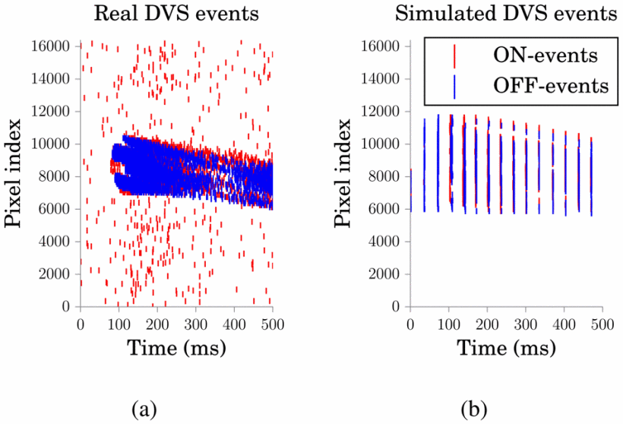
Neurorobotics Platform
J. Kaise [Kai+16]

Slide 12
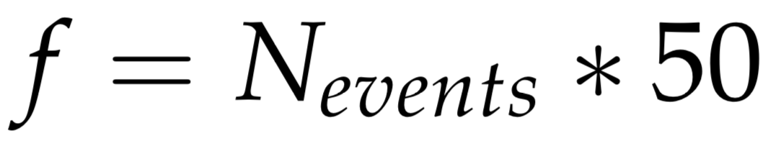
Neurorobotics Platform
Input Encoding:
Spread events over the next timestep
Crop input to relevant part
Divide input into “Superpixels”
Set Poisson Neuron to fire at a frequency corresponding to the number of events of its Superpixel:

Slide 13
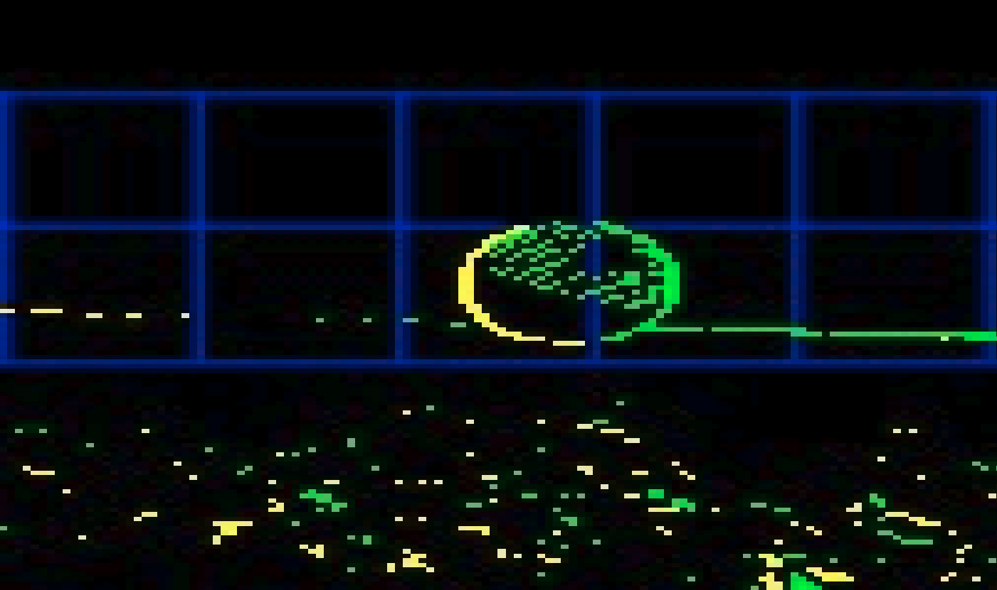
Neurorobotics Platform

Slide 14
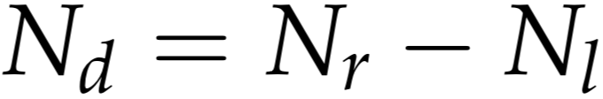
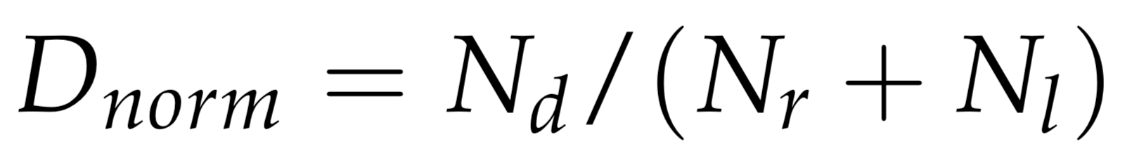
Neurorobotics Platform
Output Decoding:
2 Neurons used
Spikes of each get accumulated over last Timestep
Direction given by:
Notes:
output by 2 neurons

Slide 15
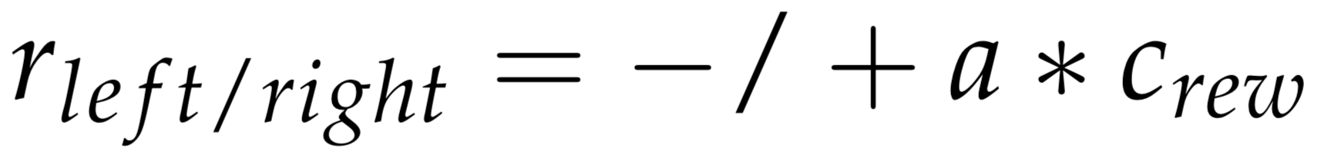
Neurorobotics Platform
Reward:
The Angle of the Head to the Target reflects the performance of the Robot
Reward for the Output Neurons scales linear according to Angle:
Dopamine Level of Synapses set according to the Reward
Notes:
to train the network a reward function has to be choosen:

Slide 16
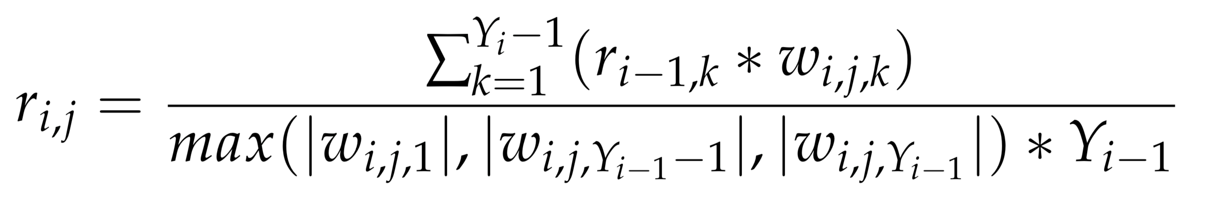
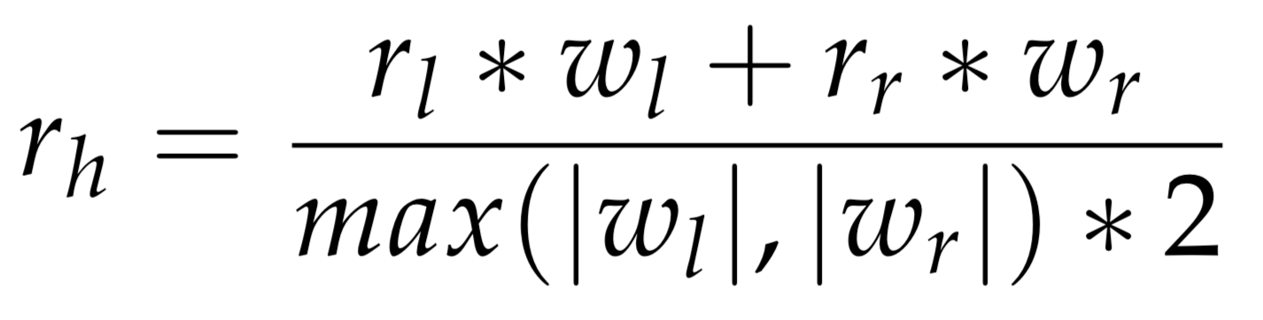
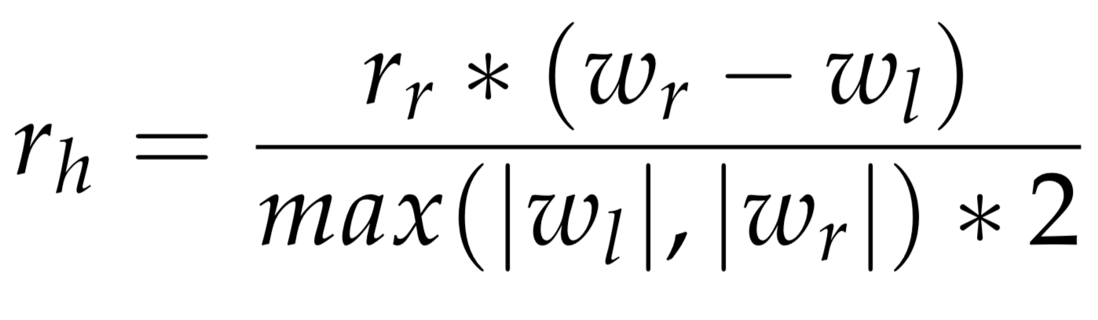
Neurorobotics Platform
Reward Propagation:
Reward unknown for Hidden Layer
Rewards of the Output Layer has to be used
Similar to the Backpropagation
Simplification in this case:
Bing, Jiang [Bin+19]
Notes:
reward can not be directly decided
reward for neuron:
weighted reward of all neurons it conncts to

Slide 17

Training the Networks
Robot and Ball in empty Environment:
Ball Radius: 30cm
Distance: 1.6m
Ball movement in training:
Eight like shape
Ball faster than Robot
Ball keeps distance and waits
Track mirrored after each Reset

Slide 18
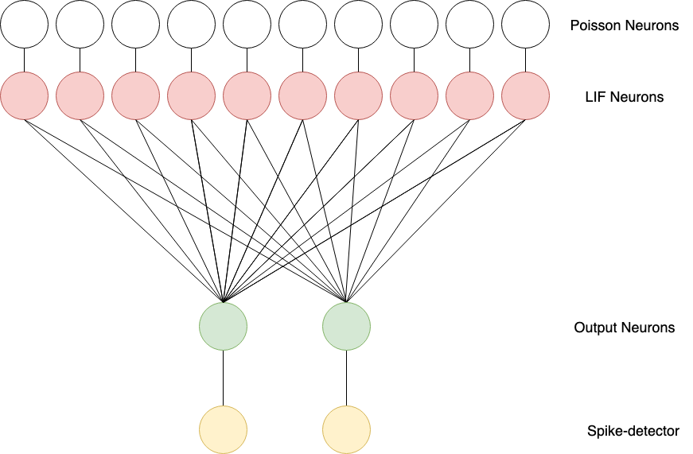
Training the Networks - Basic Network
Topology of the Network
Notes:
LIF Neurons necessary from Setup: Parrot incoming spikes

Slide 19
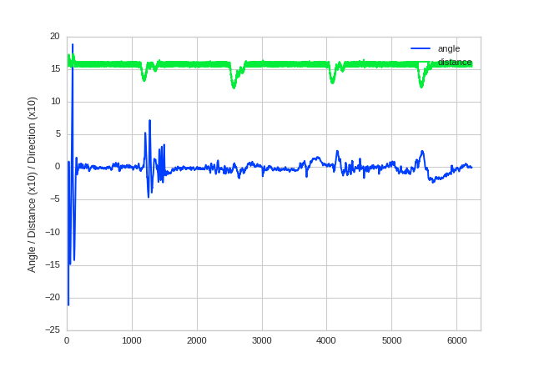
Training the Networks - Basic Network
Performance of the Network

Slide 20
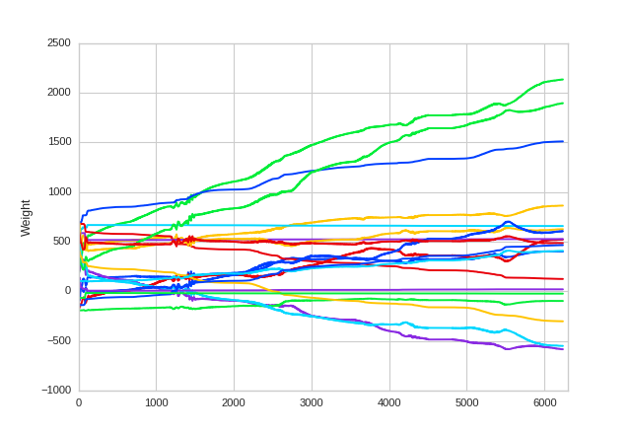
Training the Networks - Basic Network
Plot of Weights in the Network

Slide 21
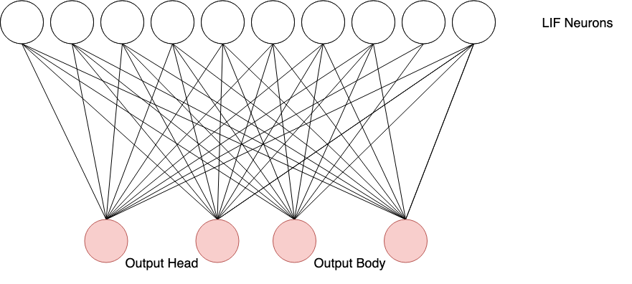
Training the Networks - Adding Head Control
Topology of the Network

Slide 22
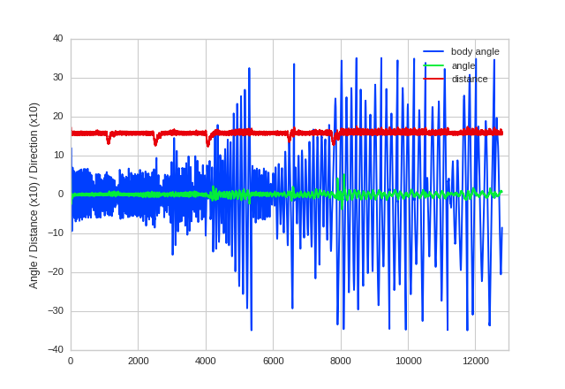
Training the Networks - Adding Head Control
Performance of the Network

Slide 23
Training the Networks - Adding Head Control
Additional Topologies:
DVS & Head Output
Joint Angles & Head Output
Training Results:
Weights do not stabilize
Networks unable to solve the task

Slide 24
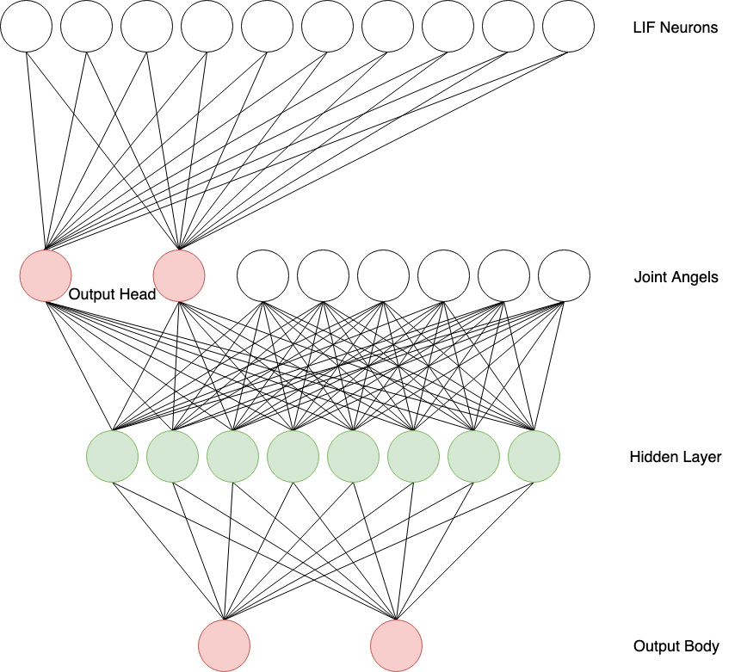
Training the Networks - Multi Layered
Topology of the Network

Slide 25
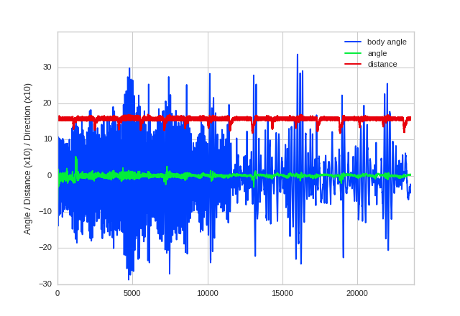
Training the Networks - Multi Layered
Performance of the Network

Slide 26
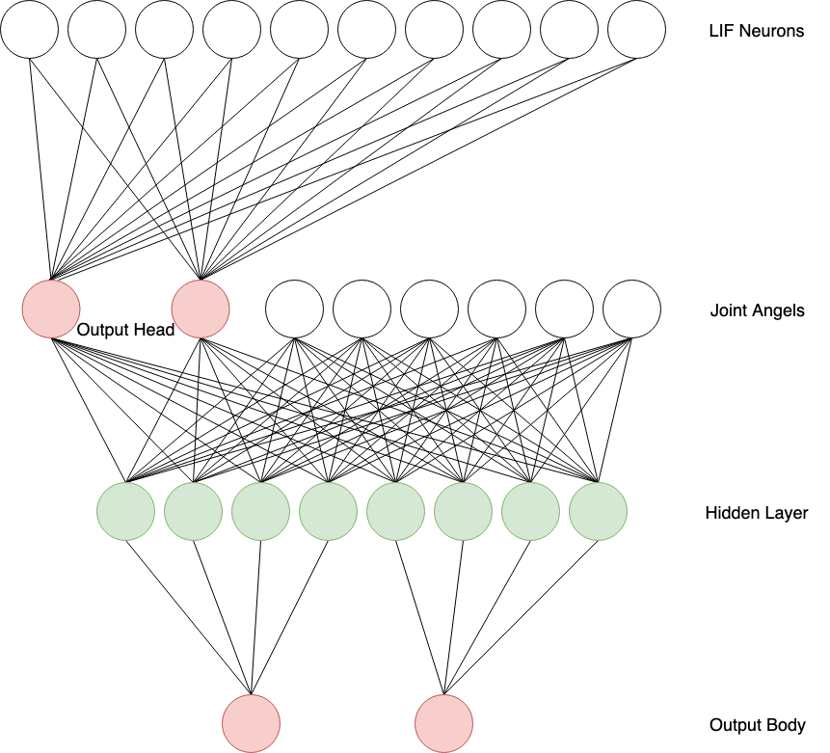
Training the Networks - Split Hidden Layer
Topology of the Network

Slide 27
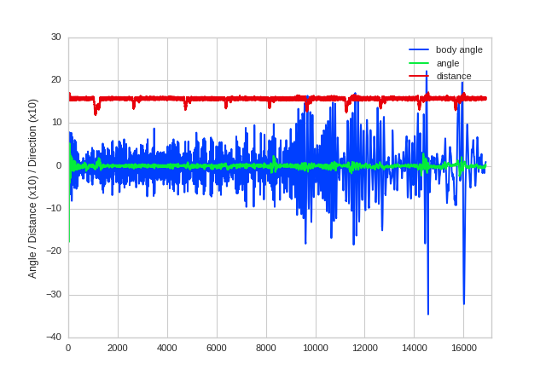
Training the Networks - Split Hidden Layer
Performance of the Network

Slide 28
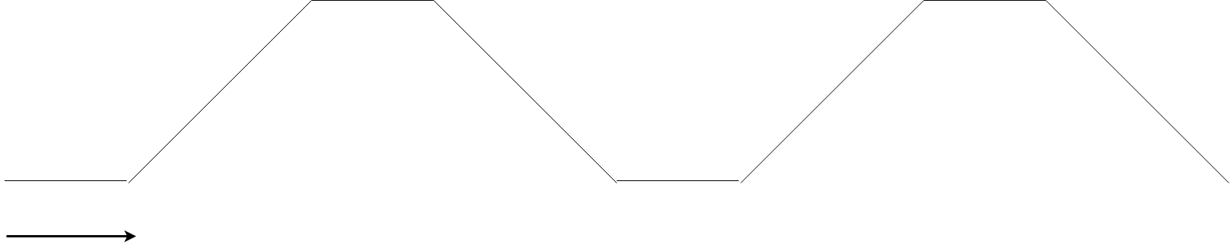
Testing
New Movement Pattern of Target:

Slide 29
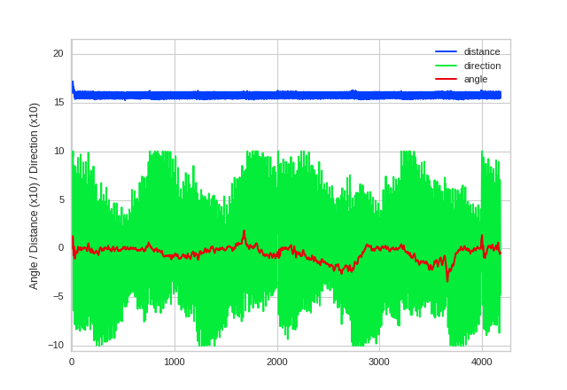
Testing – Basic Network
Solves without Fail
Good tracking of the Target
But high changes in the steering output

Slide 30
Testing – Basic Network
Performance of the Network

Slide 31
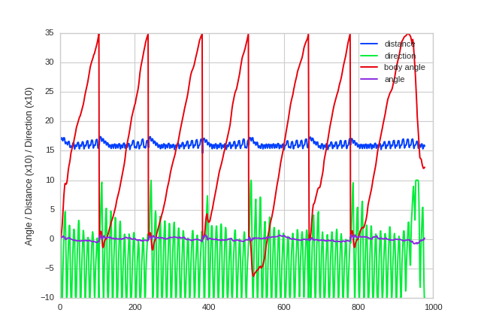
Testing – Multi Layered Network
Unable to solve
Drifting to the Right

Slide 32
Testing – Multi Layered Network
Performance of the Network

Slide 33
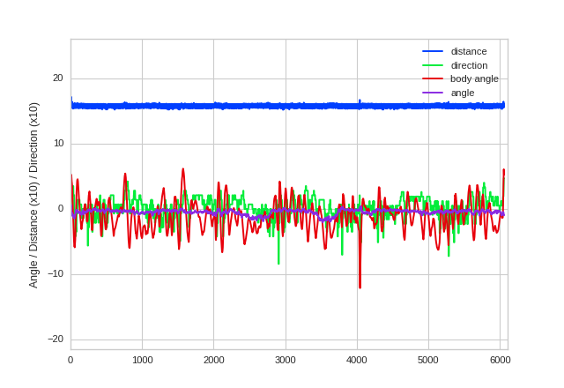
Testing - Split Hidden Layer
Solves without Fail
Very Good tracking of the Target
Body Angle to target comparable to Performance of Basic Setup
Control Signal much smoother

Slide 34
Testing - Split Hidden Layer
Performance of the Network

Slide 35
Conclusion
SNN capable of learning to Control Robot
Robust enough to handle Movement of Head
Single Layered Networks are not able to simultaneously control the direction of the Head and the Robot :
Reduction of Information provided by DVS
Information States not linear separable any more
Multi Layered Network needed

Slide 36
Conclusion
Bad Result of Multi Layered Network:
Network might not have reached a stable state in Training
Small weight changes in the hidden layer can have a amplified effect on the output
The topology of the multi layered Network can be reduced to the topology of the network with split hidden layer
Faster training of topologies designed for the task

Slide 37
Future Work
Replace Network Controlling Head with more Complex Topology to enable Object detection
Duplicate DVS Layer to distinguish event Polarity

Slide 38
Thank you for your attention!

Slide 39
Questions?

Slide 40
Sources
[JIA18] | Z. Jiang. Development and Control of a Bio-snake Robot. Oct. 2018.
[L08] | R. Legenstein, D. Pecevski, and W. Maass. “A learning theory for reward- modulated spike-timing-dependent plasticity with application to biofeed- back.” In: PLoS computational biology 4.10 (2008), e1000180.
[Kai+16] | J. Kaiser, J. C. V. Tieck, C. Hubschneider, P. Wolf, M. Weber, M. Hoff, A. Friedrich, K. Wojtasik, A. Roennau, R. Kohlhaas, et al. “Towards a framework for end-to-end control of a simulated vehicle with spiking neural networks.” In: 2016 IEEE International Conference on Simulation, Modeling, and Programming for Autonomous Robots (SIMPAR). IEEE. 2016, pp. 127–134.
[Bin+19] | Z. Bing, Z. Jiang, L. Cheng, C. Cai, K. Huang, A. Knoll, et al. “End to End Learning of a Multi-layered SNN Based on R-STDP for a Target Tracking Snake-like Robot, to be appear.” In: 2019 IEEE International Conference on Robotics and Automation (ICRA). 2019.

Slide 41
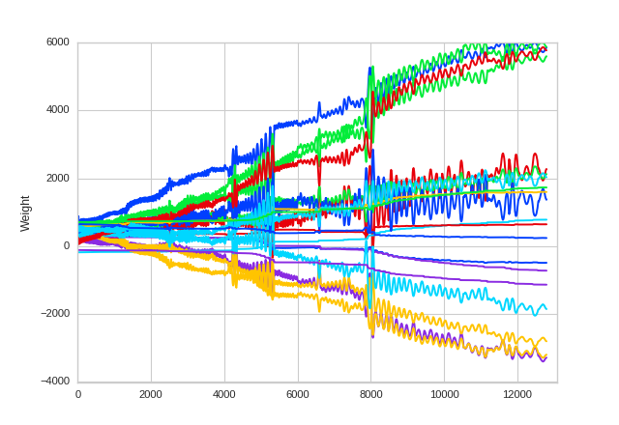
Training the Networks - Adding Head Control
Plot of Weights in the Network

Slide 42
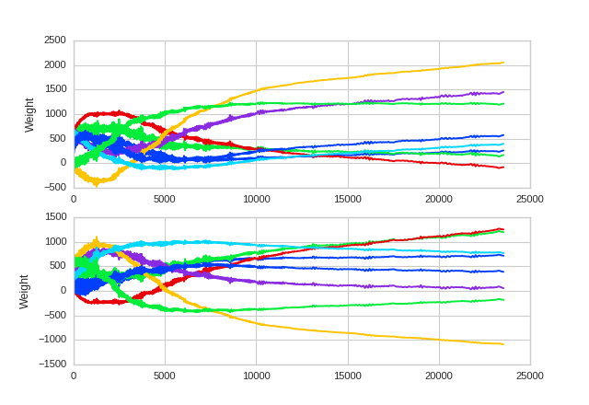
Training the Networks - Multi Layered
Plot of Weights in the Network

Slide 43
Training the Networks - Multi Layered
Plot of Weights in the Network

Slide 44
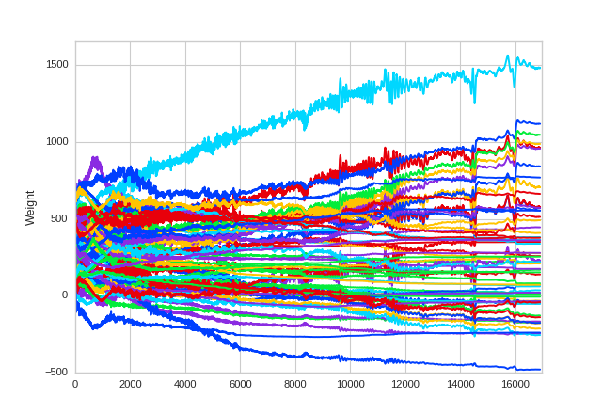
Training the Networks - Split Hidden Layer
Plot of Weights in the Network

